Slide 1
Mutual Aid Box Alarm System
Notes:
IMPORTANT TO UNDERSTAND
MABAS is an agreement… Just like any mutual aid agreement two fire departments or multiple departments sign to provide mutual aid services. It the agreement that creates the organization of MABAS and places Board Members on an Executive Board from each division to direct the activities of the organization. MABAS is not an organization that takes over scenes of directs department activities. It’s the mutual aid agreement that provides the terms of use.

Slide 2
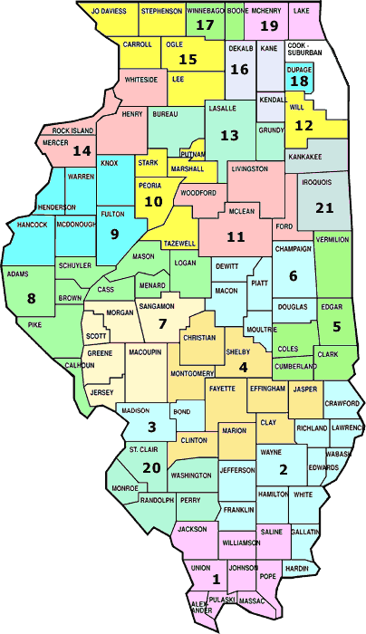
MABAS History
Started in 1960’s in northern Illinois
Every municipality adopts the same mutual aid agreement
Designated common radio channels
Preprogrammed responses (Box cards)
Scalable from day-to-day incidents to large scale disasters
Centralized Communications & Coordination
All 50 States have a form of Intra-State Mutual Aid (MABAS)
Michigan, Indiana, Illinois, Wisconsin, Minnesota form Great Lakes MABAS

Slide 3
What is MIMABAS?
The ONLY STATEWIDE Michigan Fire Service Mutual Aid Agreement
A Source for Fire/EMS/Rescue Inter/Intra-State Mutual Aid Resources
A Statewide Dispatch and Communications System
An Organization Owned and Directed by the Michigan Fire Service
Michigan Task Force 1 – Type III USAR
Notes:
IMPORTANT TO UNDERSTAND
Departments that join MABAS are not required to provide statewide resources. There are many departments and divisions that don’t have the resources to send support out of their division. But there are many that can support other divisions. Again, this is not a requirement!

Slide 4
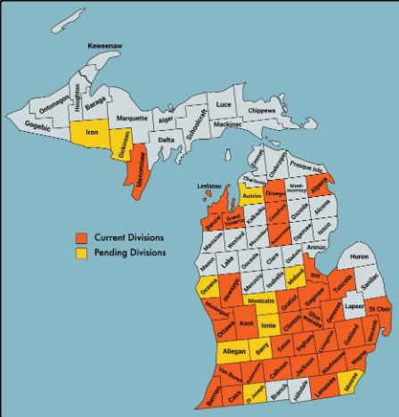
Michigan MABAS Communities Working Together For Safety
32 Divisions
500+ Fire Departments
Notes:
IMPORTANT TO UNDERSTAND
MABAS provides organized support, policies and procedures to help fire departments to pre-plan for large events and escalating disasters. The planning starts with each department identifying the type of responses they make to specific geographic areas of their jurisdiction. This includes fires in areas with or without hydrants, EMS and Special Operations Calls. MABAS uses template box cards for this planning process.

Slide 5
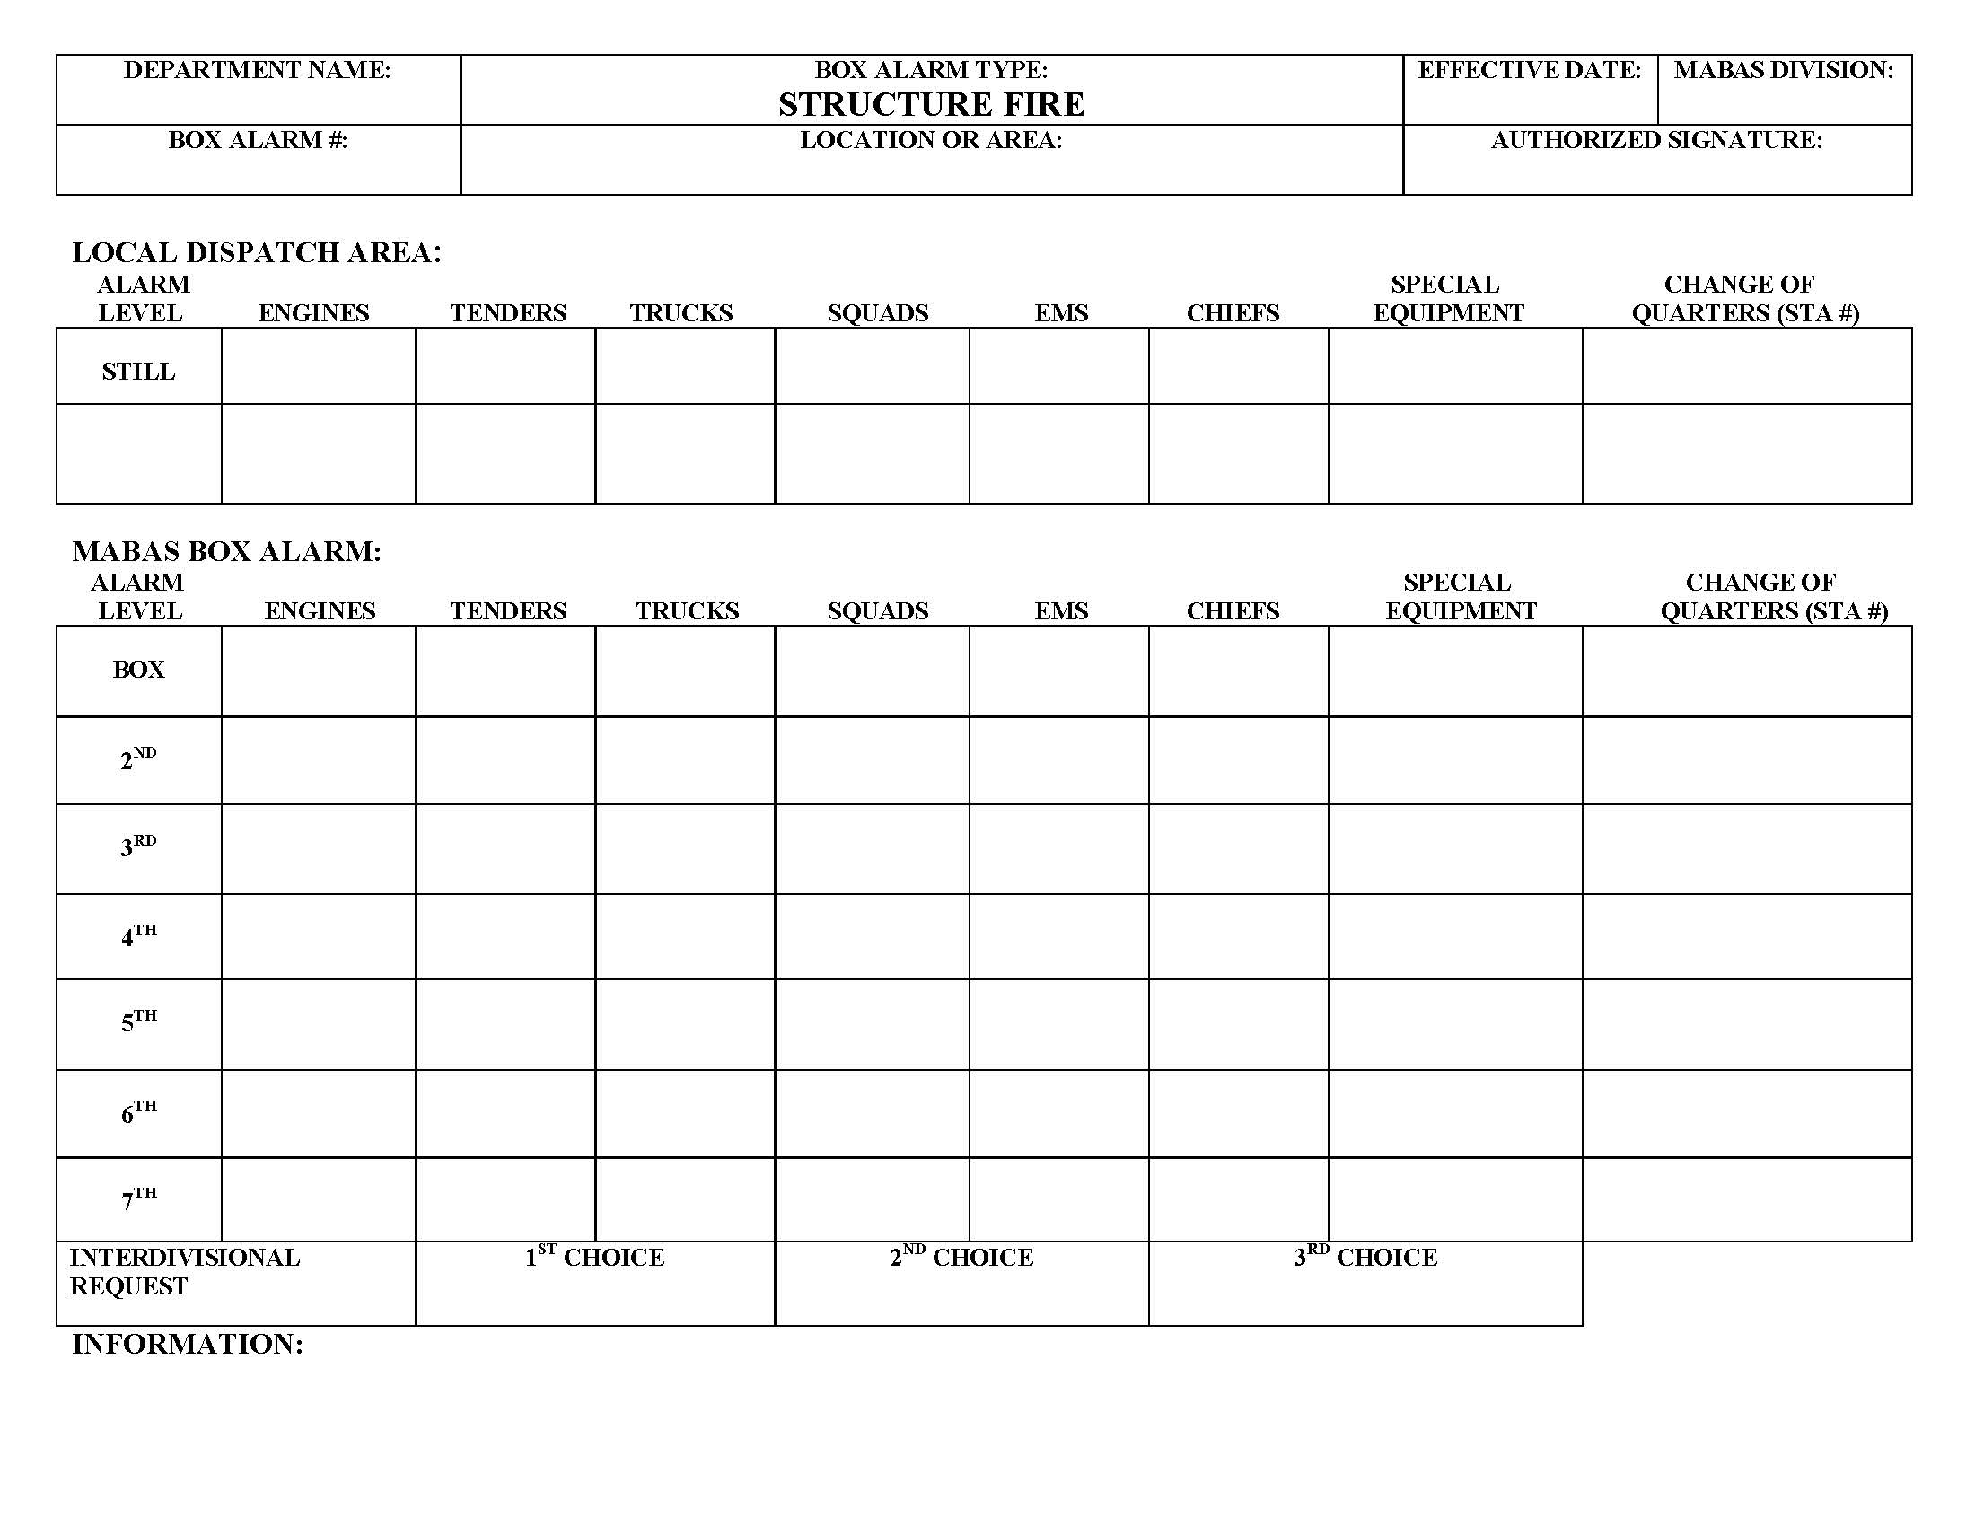
AUTOMATIC MUTUAL AID
Notes:
IMPORTANT TO UNDERSTAND
Cards provide dispatch with a preplanned response for up to five alarms.
“Still” are the resources that your department provides for the response.
“Automatic Mutual Aid” are the resources that are automatically sent on a call with your “STILL” resources.
“BOX” is the first Mutual Aid request that are not automatically sent on the initial tone. 2nd, 3rd, etc. continue to buildout additional mutual aid requests that can be made by the IC by simply requesting the “Next Box” from dispatch.
“Inter-Divisional Request” are for out of county or division resources that are not currently built into the Box Card. This is the key to the statewide agreement, once you sign you can request mutual aid from resources that you have never worked with.
“Change of Quarters” is a move up request for an agency to occupy your fire station to respond to other calls in your jurisdiction.
Each department identifies their choice of mutual aid units. This is not a MABAS decision, it’s the local Fire Chief’s decision.
Mutual aid units sign off indicating their commitment before implementing.
This makes life much easier for the dispatch center when the calls have been pre-planned.

Slide 6
2020 Michigan Mutual Aid Stats
40% of all Fire Calls, in 2020, required Mutual , per NFIRS reporting.
Notes:
IMPORTANT TO UNDERSTAND
Fire Service recruitment and retention difficulties, decreasing budgets, and the increase in demand for the fire service at larger events have perpetuated the need for mutual aid. See Graph!

Slide 7
MIMABAS Resources (MRP’s)
Fire/EMS Operations
Special Operations
Engine Strike Teams
Fire Task Forces
EMS Strike Teams
Tanker Strike Teams
Tanker Task Forces
Brush Strike Teams
Type III Crew Transport
Hazardous Materials Teams
High Angle Rescue
Swift Water Rescue
Trench Rescue
Collapse Rescue
Tower Rescue
Confined Space
Type III USAR Task Force
Notes:
IMPORTANT TO UNDERSTAND
MABAS, the organization, works with Divisions to create Mission Ready Packages (MRP’s). Participation is NOT A REQUIREMENT TO SIGN MABAS AGREEMENT. MRP’s follow NIMS typing for Fire, EMS and Special Operations resources. These resources can be requested through the Michigan RED CENTER.

Slide 8
Statewide MIMABAS Communications Center
Located in Ann Arbor, Michigan
Full Time Dispatch Center
Communicates via MIMABAS 800 MHz Statewide Radio Channels (State 800 MHz System)
Supports Local Division Dispatch Centers
Dispatches Special Operations Resources and Out of State EMAC Requests
Notes:
IMPORTANT TO UNDERSTAND
The Michigan RED CENTER is the MABAS statewide dispatch center. Each MABAS Division has selected a Division Dispatch Center to support intra-division and inter-divisional (Out of Division) resource requests. When an MRP is needed the Division Dispatch Center contacts the Red Center on the dedicated Red Center phone system. The Red Center collects the information and then dispatches the MRP through that MRP’s Division Dispatch Center. The Red Center never replaces the local dispatch center but supports them as needed. The State of Michigan EOC can also request MABAS resources through the Red Center during a disaster, including EMAC requests.

Slide 9
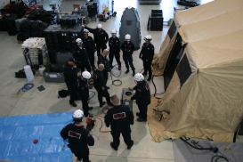
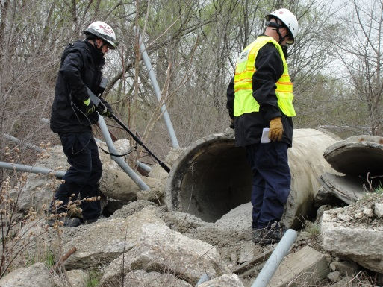
Michigan TF1
Michigan Taskforce 1’ is a Type III Taskforce that also provides MRP’s including:
USAR “RESCUE” STRIKE TEAMS
USAR “SEARCH” STRIKE TEAMS
USAR ADVISORY TEAM
SWIFT WATER RESCUE
Notes:
IMPORTANT TO UNDERSTAND
MITF1 is a highly trained team that provides specialized MRP’s to support local events and disasters. Activation of any or all MITF1 MRP’s can be made through the Michigan MABAS Red Center.

Slide 10
For More Info…
www.mabasmi.org

